Slide 1
Innopolis University
09.03.01 · Computer Science
Bachelor's Thesis Defense
Bridging the Enforcement Verification Gap
Detecting Divergence Between Declared and Actual Security Posture in Kubernetes Containerized Environments
AUTHOR
SUPERVISOR
Yehia Sobeh
Kirill Saltanov
Innopolis · 2026

Slide 2
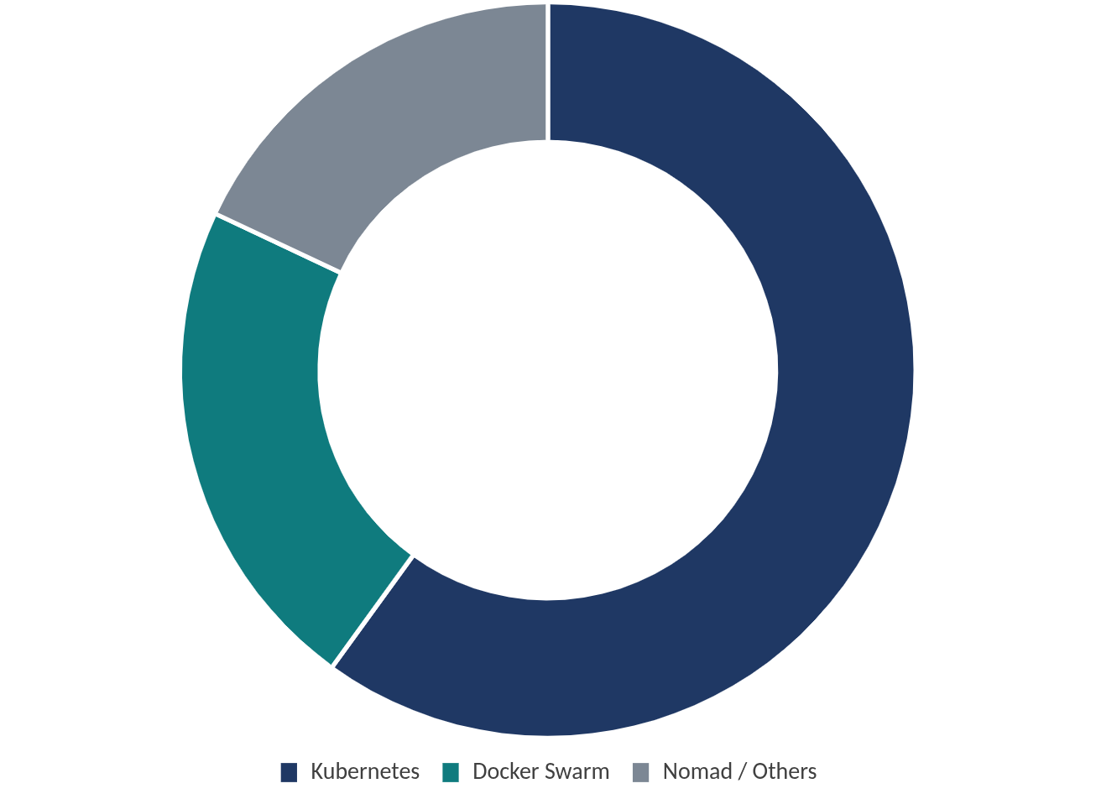
Motivation: The Problem with Declarative Security
Chapter 1 · Introduction
Why This Matters
Container Orchestrator Share (Production)
Over 60% of organizations running containers in production use Kubernetes (CNCF survey, 2024).
This creates a large attack surface:
hundreds of containers per cluster
third-party images of varying trustworthiness
continuous scaling and dynamic workloads
All of this is secured by declarative YAML policies.
Critical Assumption
Every existing tool (OPA Gatekeeper, Kyverno, Kubescape, Trivy) assumes that if the Kubernetes API reports a security property, the container runtime has faithfully enforced it .
CNCF Annual Survey, 2024 · production deployments
This thesis demonstrates: that assumption does not always hold. A privileged container that declares seccomp filtering has that filter silently removed by the Docker runtime — and no existing tool detects this.
Why this matters at scale
A silent enforcement failure in a single Docker default propagates to millions of production pods across the industry.
Yehia Sobeh · Bridging the Enforcement Verification Gap
2 / 17

Slide 3
The Enforcement Verification Gap
Chapter 1 · Problem Statement
From YAML declaration to kernel enforcement, the pod spec passes through four translation hops — each one can silently drop a restriction.
HOP 1
HOP 2
HOP 3
HOP 4
Kubernetes API
Kubelet → CRI
Container Runtime
runc + Linux Kernel
Pod securityContext declared by the operator.
Translates the spec into a Container Runtime Interface request.
Docker / containerd / CRI-O generates the OCI runtime spec.
Configures namespaces, cgroups, capabilities, seccomp.
Where Existing Tools Look — and Where the Gap Lives
Hop 1
Hop 2
Hop 3
Hop 4 (kernel)
OPA / Kyverno
✓
—
—
—
Falco / KubeArmor
—
—
—
behaviour only
k8s-psa (this work)
✓
—
✓
✓
Formal Definition
Research Questions
The enforcement verification gap is the absence of tooling that systematically verifies whether the security context declared in a Kubernetes pod specification is faithfully enforced at the container runtime level.
RQ1. Does kernel-level state actually diverge from the declared spec, and under what conditions?
RQ2. Can a lightweight node-resident agent detect these divergences with bounded overhead?
RQ3. What categories of divergence occur in practice, and how should each be classified?
Yehia Sobeh · Bridging the Enforcement Verification Gap
3 / 17

Slide 4
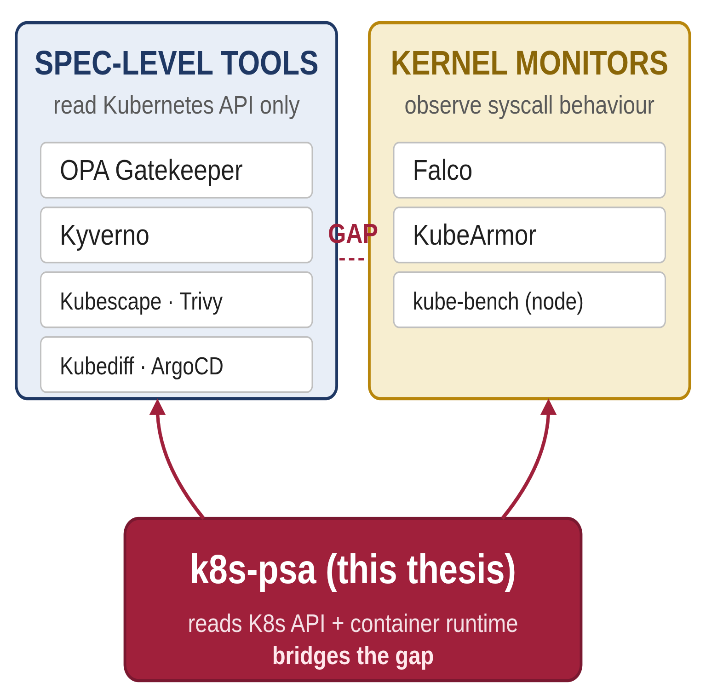
Literature Review: No Existing Tool Bridges Both Ends
Chapter 2 · Literature Review
A systematic walkthrough of every tool category in the Kubernetes security ecosystem confirms that the gap is real and unaddressed.
The Kubernetes Security Tool Landscape
Tool / Category
Data source
Drift?
OPA Gatekeeper
K8s API
No
Kyverno
K8s API
No
Kubescape / Trivy Operator
K8s API
No
Falco / KubeArmor
Kernel (eBPF, syscalls)
No *
Kubediff / ArgoCD / FluxCD
K8s API + Git
No
kube-bench
Node filesystem
No
k8s-psa (this thesis)
K8s API + container runtime
Yes ✓
* Falco detects syscall anomalies but cannot tell whether a declared restriction silently failed to apply. Wong et al., Devi Priya et al., and CloudSecBurrito name this gap as an open research direction.
Adapted from Fig. 2.6 — every existing tool sits on one side of the gap.
Yehia Sobeh · Bridging the Enforcement Verification Gap
4 / 17

Slide 5
Seccomp: The Security Primitive Most Affected
Chapter 2 · Seccomp in Kubernetes
A Linux kernel BPF filter declared in YAML, translated through four layers, and silently lost in the most common privileged-mode case.
Three Seccomp Profile Types
Unconfined
RuntimeDefault
Localhost
No filter at all. Every syscall is permitted. Historically the default. Exposes mount, ptrace, kexec_load, reboot.
The runtime's built-in BPF allowlist. Blocks ~36 syscalls historically used in container escapes while permitting all common workload calls.
A custom BPF profile loaded from the node filesystem. Strictest option — allows only what the specific application needs.
Three Properties Make Seccomp Vulnerable to Silent Failure
1. Asymmetric Default
2. Privileged-Mode Override
3. Opaque Metadata
Seccomp is opt-in. A pod without a seccompProfile runs Unconfined unless the kubelet is explicitly configured otherwise. KEP-2413 started changing this; migration is incomplete.
Docker silently strips declared seccomp profiles from privileged containers (Moby issue #41321). The spec still reports RuntimeDefault — the kernel applies no filter. This is the central enforcement gap.
When cri-dockerd forwards a RuntimeDefault declaration, no explicit SecurityOpt entry is recorded. docker inspect cannot distinguish a protected container from an unprotected one.
Yehia Sobeh · Bridging the Enforcement Verification Gap
5 / 17

Slide 6
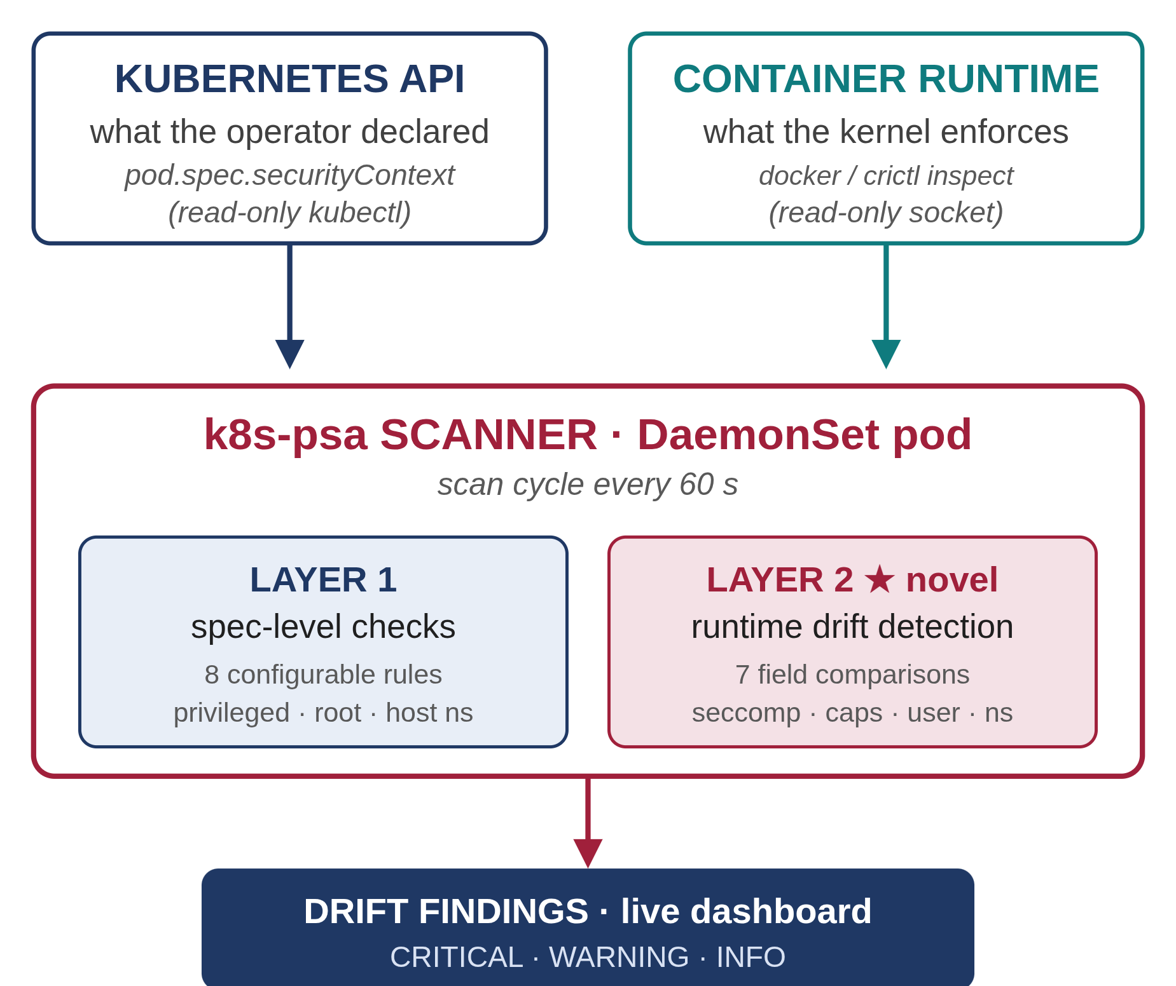
k8s-psa: Architecture Overview
Chapter 3 · Design & Methodology
k8s-psa Data Flow — One DaemonSet per Node
Design Principle
Verification requires two independent data sources : the K8s API for declared intent, the runtime for kernel-enforced reality.
Layer 1 — Specification
API only. Functionally equivalent to OPA / Kyverno.
privileged · root · host ns · seccomp · caps · read-only root
Layer 2 — Drift Detection ★ novel
API + runtime. Spec field vs. live runtime field.
privileged · user · capabilities · seccomp · rootfs+noNewPriv · host ns · masked paths
Severity: CRITICAL · WARNING · INFO
Adapted from Fig. 3.1 · high-level data flow.
Yehia Sobeh · Bridging the Enforcement Verification Gap
6 / 17

Slide 7
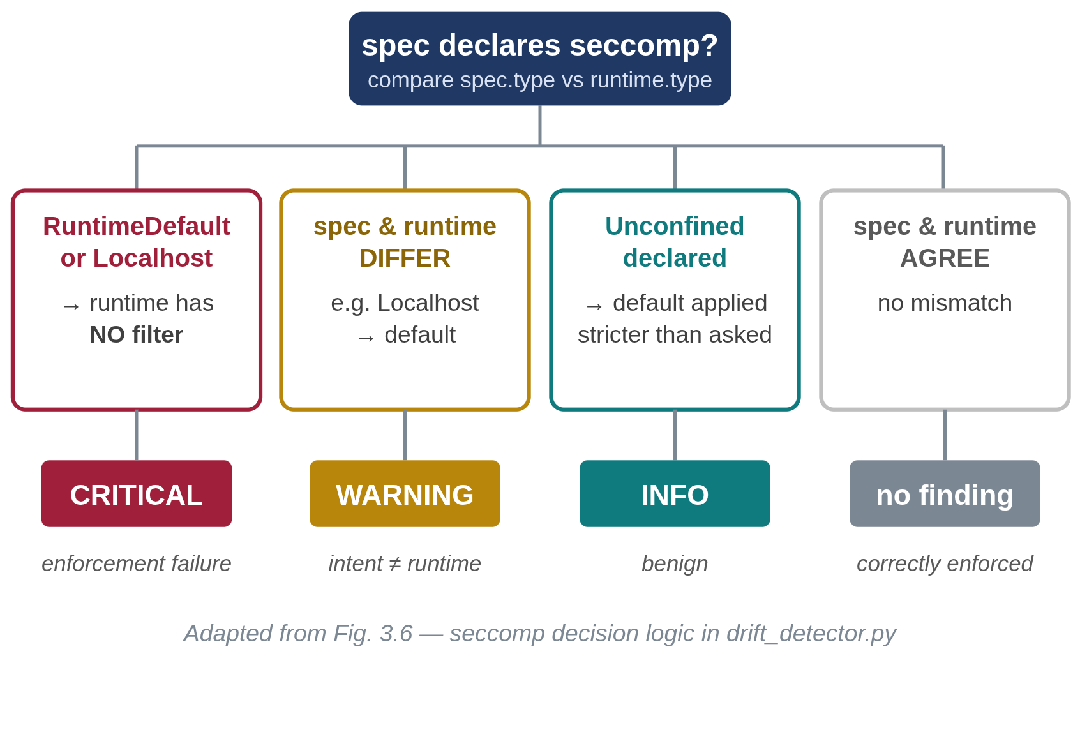
Two Design Decisions That Make Layer 2 Work
Chapter 3 · Design Details
1. Capability Normalization
2. Seccomp Comparison Logic
The Linux kernel grants 14 default capabilities to every non-privileged container, even when the spec lists zero. A naïve comparison emits 14 false positives per pod.
Four rules govern when a seccomp mismatch is a finding:
def compute_expected(add, drop):
if "ALL" in drop:
expected = set()
else:
expected = DEFAULTS - set(drop)
expected = expected | set(add)
return expected
For privileged containers
Docker grants all 41 capabilities. The algorithm deliberately does NOT expand the expected set to 41. Result: 27 WARNING findings — correctly surfacing the inflation that privileged mode silently introduces.
Yehia Sobeh · Bridging the Enforcement Verification Gap
7 / 17

Slide 8
Seven Purpose-Built Test Pods
Chapter 3 · Evaluation Design
Designed to isolate individual variables — the scientific control at the heart of the evaluation.
#
Pod Name
Security Configuration
Scientific Role
1
Fully Hardened
drop ALL · runAsUser 1000 · RuntimeDefault · readOnlyRootFs · no escalation
Negative control — expect zero findings
2
No Security Context
No securityContext at all
Empty baseline
3
Privileged + Seccomp ★
privileged: true + seccompProfile: RuntimeDefault
KEY scenario — exposes the gap
4
Privileged, No Seccomp
privileged: true (no seccomp declaration)
Scientific control for Pod 3
5
Partial Security
drop NET_RAW, SYS_ADMIN + RuntimeDefault + runAsUser 1000
Tests partial capability drops
6
No Privilege Escalation
allowPrivilegeEscalation: false + full hardening
Tests noNewPrivileges mapping
7
Host Namespaces
hostPID + hostNetwork + hostIPC
Tests namespace mode translation
Controlled Experiment — Pod 3 vs. Pod 4
Both pods declare privileged: true and end up with identical runtime state — all 41 capabilities, no seccomp, no masked paths. The only variable that differs is the seccomp declaration in Pod 3's spec. If the tool is correct: Pod 3 → 1 CRITICAL · Pod 4 → 0 CRITICAL. That asymmetry proves specificity.
Independent confirmation: the same scenario was tested against four real Kubernetes control-plane components — etcd, kube-apiserver, kube-controller-manager, kube-scheduler.
Yehia Sobeh · Bridging the Enforcement Verification Gap
8 / 17

Slide 9
Implementation: Python 3.12 · 9 Modules · 2 Runtime Adapters
Chapter 4 · Implementation
Module Organization
Data Extraction
Analysis
Output
pod_scanner.py
policy_engine.py
alert_manager.py
spec_extractor.py
normalizer.py
main.py
runtime_inspector.py
drift_detector.py
dashboard/server.py
Calls kubectl, parses pod JSON, abstracts the container-runtime backend.
Layer 1 policy checks, capability normalization, Layer 2 field-by-field comparisons.
NDJSON alerts on host volume, scan-loop orchestrator, real-time Chart.js dashboard.
Runtime Adapters
Docker Adapter
containerd Adapter
Calls docker inspect and parses HostConfig.SecurityOpt, CapAdd/Drop, Privileged, ReadonlyRootfs, PidMode, NetworkMode, IpcMode, Config.User.
Calls crictl inspect and reads info.runtimeSpec (full OCI spec) directly — full seccomp BPF rule set from linux.seccomp. Eliminates the observability gap.
44 unit tests · runs in 0.2 s · no cluster needed | One-command deploy: kubectl apply -f deployments/all-in-one.yaml
Yehia Sobeh · Bridging the Enforcement Verification Gap
9 / 17

Slide 10
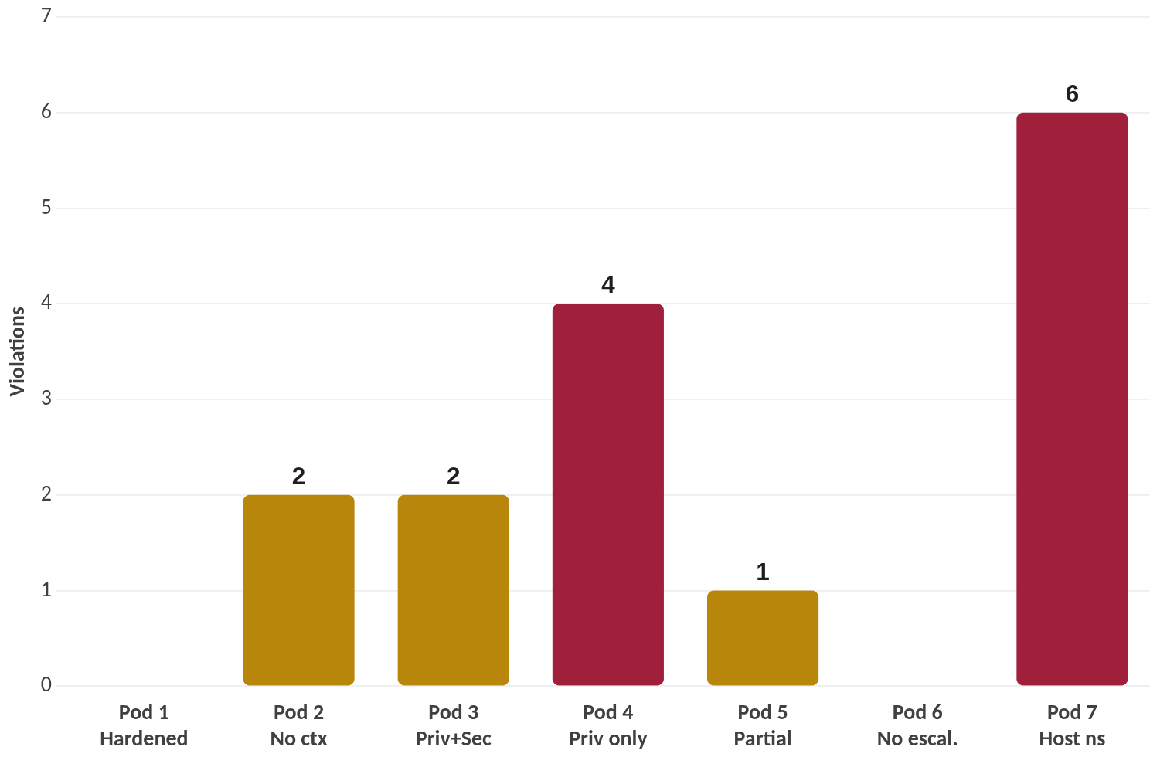
Layer 1 Results: Specification-Level Violations
Chapter 5 · Evaluation — Layer 1
Eight policy checks across seven test pods — baseline correctness confirmed before interpreting Layer 2 findings.
Pod
Test Pod
Violations
Unique Spec Violations per Pod (Table 5.1)
1
Fully Hardened
0
2
No Security Context
2
3
Privileged + Seccomp
2
4
Privileged, No Seccomp
4
5
Partial Security
1
6
No Privilege Escalation
0
7
Host Namespaces
6
Green = compliant · Gold = warning · Red = critical. Pod 7 highest (6), Pods 1 & 6 fully compliant.
Yehia Sobeh · Bridging the Enforcement Verification Gap
10 / 17

Slide 11
Finding 1: Docker Silently Strips Seccomp (TRUE POSITIVE)
Chapter 5 · Central Result — Pod 3 vs. Pod 4 Controlled Comparison
Pod 3 — privileged: true + seccomp: RuntimeDefault
Pod 4 — privileged: true (no seccomp declared) — CONTROL
Kubernetes Spec:
Kubernetes Spec:
privileged: true
seccompProfile:
type: RuntimeDefault
privileged: true # no seccompProfile
Container Runtime (what Docker does):
Container Runtime (what Docker does):
capabilities: all 41 granted
seccomp: stripped
capabilities: all 41 granted seccomp: STRIPPED
→ 0 seccomp findings + 27 WARNING
→ 1 CRITICAL + 27 WARNING
Both pods have byte-identical runtime state. The only difference is one line of YAML — 1 CRITICAL for Pod 3 vs. 0 for Pod 4. Controlled proof of the enforcement gap.
Independent confirmation — Kubernetes control plane (Table 5.3)
Why this matters
System Pod
CRIT
WARN
INFO
The four privileged control-plane pods reproduce Pod 3's finding on a real Kubernetes deployment. Invisible to OPA Gatekeeper, Kyverno, Kubescape, Trivy Operator .
etcd-minikube
1
0
1
Documented in Moby #41321 since 2020 — never previously detected by any verification tool.
kube-apiserver-minikube
1
0
1
kube-controller-manager-minikube
1
0
1
kube-scheduler-minikube
1
0
1
kube-proxy
0
27
1
storage-provisioner
0
0
1
Yehia Sobeh · Bridging the Enforcement Verification Gap
11 / 17

Slide 12
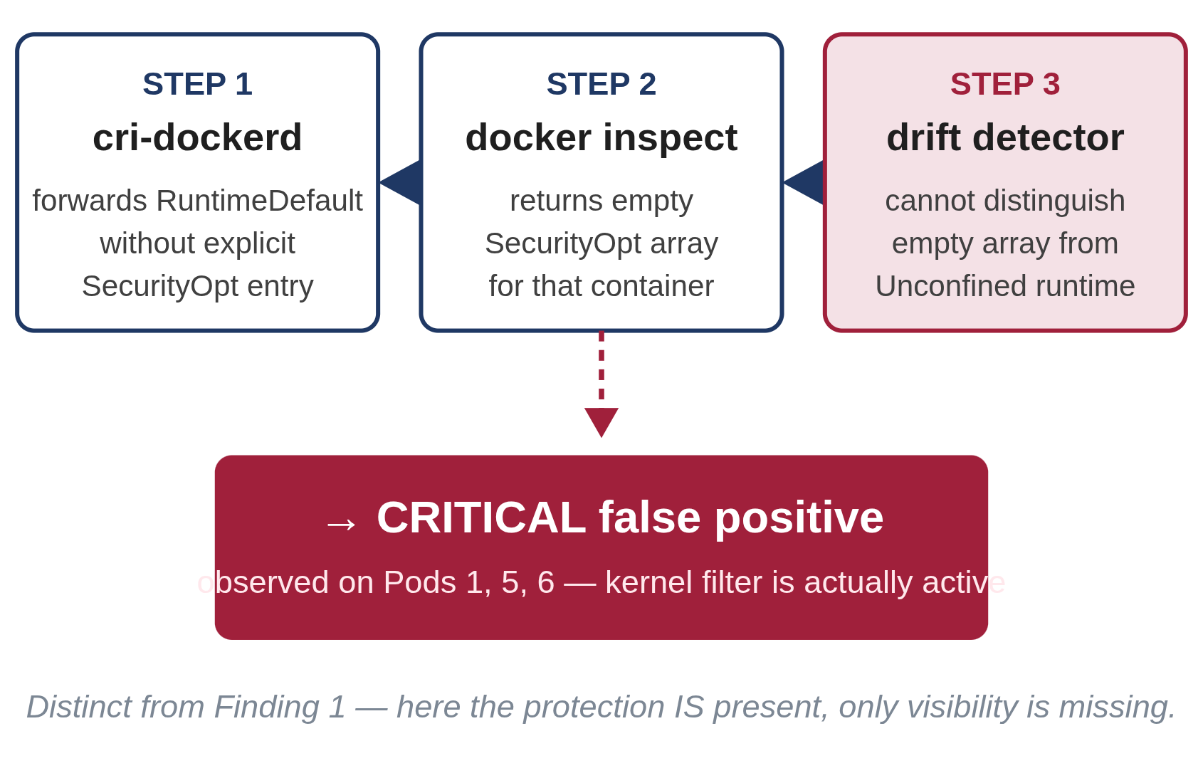
Finding 2: docker inspect Hides Implicit Seccomp Defaults
Chapter 5 · Observability Artefact — distinct from Finding 1
What I Observed
Lesson
Pods 1, 5, and 6 — non-privileged, correctly declaring RuntimeDefault — also produced CRITICAL seccomp findings. But these containers are actually protected. The kernel is applying a seccomp filter. The findings are false positives.
Runtime metadata is a lossy abstraction. Any tool that relies on docker inspect for seccomp verification will produce these false positives.
Docker acknowledges this in CIS Docker Benchmark check 5.21 — an empty SecurityOpt means the default profile is active, not that seccomp is disabled.
Root Cause — Three-Step Chain
Definitive Fix — Read the Kernel
# Bypass docker inspect entirely $ cat /proc/$PID/status | grep Seccomp
Seccomp: 2
# 2 = BPF filter mode active
Finding 1 (real risk)
Finding 2 (artefact)
Privileged containers — enforcement gap. The kernel literally has no filter.
Non-privileged containers — observability gap. The filter is active, but metadata hides it.
Yehia Sobeh · Bridging the Enforcement Verification Gap
12 / 17

Slide 13
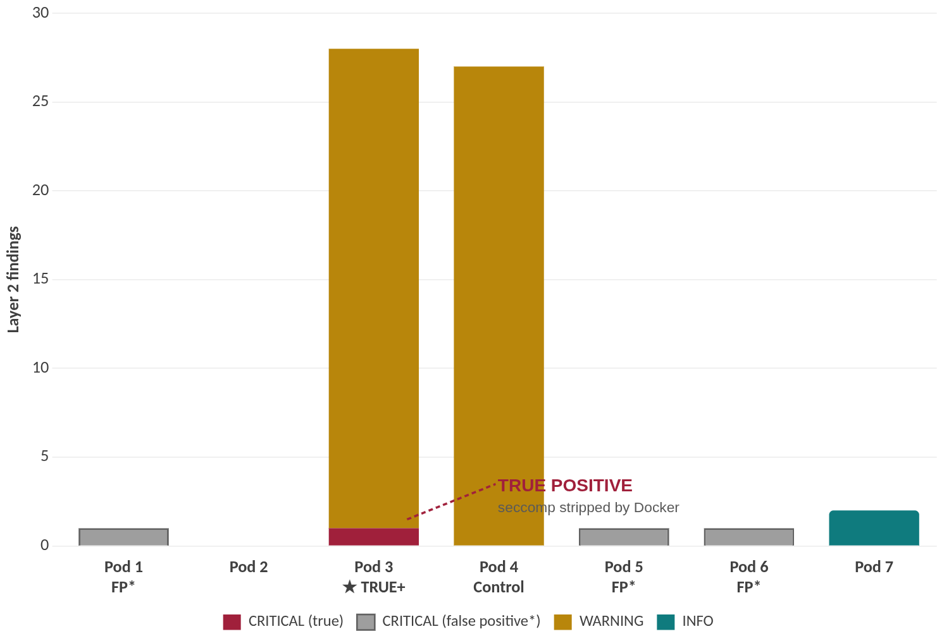
Full Evaluation Results — Layer 2 Drift Findings
Chapter 5 · k8s-psa Live Dashboard
7 + 6
3
8
pods evaluated | test + system
scan cycles · 60 s each
unique CRITICAL · 4 test + 4 system
Layer 2 Drift Findings by Pod & Severity
1
CRITICAL · Pod 3 ✓
privileged + seccomp declared
0
CRITICAL · Pod 4 ✓ control
privileged · no seccomp declaration
27
WARNING per privileged pod
41 granted − 14 default = capability inflation
Every predicted finding appeared. The Pod 3 vs Pod 4 asymmetry proves the tool detects the enforcement gap, not general privileged-mode noise.
Solid bar = true positive · Grey bar = observability false positive (cri-dockerd metadata gap · Finding 2)
Yehia Sobeh · Bridging the Enforcement Verification Gap
13 / 17

Slide 14
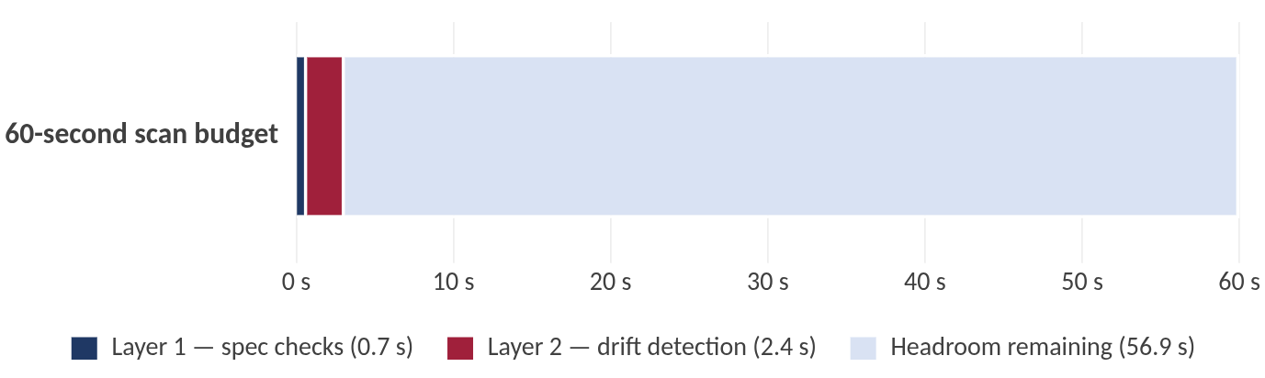
Answering the Three Research Questions
Chapter 5 · Discussion
#
Question
Answer
Status
RQ1 Empirical
Does divergence actually exist?
Yes. Docker silently strips declared seccomp from privileged containers. The K8s API reports RuntimeDefault ; the kernel applies no filter. Confirmed by Pod 3 vs. Pod 4 controlled comparison.
CONFIRMED
RQ2 Engineering
Can a lightweight tool detect it?
Yes. k8s-psa successfully detects enforcement divergences with a lightweight footprint — completing full scan cycles in seconds, consuming minimal memory and CPU, and requiring no modifications to existing cluster security mechanisms.
CONFIRMED
RQ3 Taxonomy
What categories of divergence occur?
Three: (1) enforcement gap — seccomp stripped from privileged containers; (2) capability inflation — 27 extra caps granted by privileged mode; (3) observability artefact — Docker metadata hides implicit defaults.
3 CATEGORIES
Performance Footprint
≈ 3.1 s
64 + 32 MiB
Scan Cycle vs. 60-second Budget
Scan cycle | 16 pods / 18 containers
Memory | scanner + dashboard
< 100 m
44 · 0.2 s
CPU usage | against 100 m limit
Unit tests | no cluster required
5.2% of the 60 s budget used · 56.9 s headroom (Table 5.5).
Yehia Sobeh · Bridging the Enforcement Verification Gap
14 / 17

Slide 15
Limitations — Honest Scope
Chapter 6 · Limitations
Four scope decisions bound the conclusions of this work. None of them invalidate the central finding — each maps cleanly to a future-work item on the next slide.
1 · Single Runtime Tested
2 · Metadata-Based Seccomp Check
Evaluation uses Minikube + Docker only. The containerd adapter is implemented and unit-tested, but not exercised in cluster experiments.
Layer 2 reads docker inspect rather than the kernel directly. This is precisely what produced the false positives on Pods 1, 5, and 6 — Finding 2.
Impact: the seccomp-stripping finding is confirmed for Docker; cross-runtime reproducibility is open.
Impact: the observability gap is a known, characterised limitation, not an unknown unknown.
3 · Single-Node Cluster
4 · CLI-Based Inspection
Multi-node clusters, NetworkPolicy enforcement, and service-mesh interactions (Istio, Linkerd) were not in scope.
The tool shells out to kubectl and docker rather than using native Python client libraries.
Impact: some parsing fragility under version skew; functionally complete on the tested versions.
Impact: findings are conservative — they hold per-node; multi-node behaviour is open.
Yehia Sobeh · Bridging the Enforcement Verification Gap
15 / 17

Slide 16
Future Work — Natural Next Steps
Chapter 6 · Future Work
Each limitation maps directly to a concrete next step. The two findings are mature enough that publication is the recommended next move.
1 · Kernel-Level Seccomp Verification
2 · Cross-Runtime Evaluation
Read /proc/<pid>/status directly. A value of Seccomp: 2 confirms BPF mode regardless of what Docker's metadata reports.
Deploy on containerd (kind, GKE, EKS) and CRI-O (OpenShift). Does the seccomp-stripping reproduce? Is the observability gap absent on containerd?
Eliminates the observability gap entirely — addresses Limitation 2.
Addresses Limitation 1.
3 · Mutating-Webhook Drift
RESEARCH
4 · Publication
RECOMMENDED
Admission webhooks (PSA, custom controllers) can silently add or modify seccomp profiles after the user submits the spec. A potential third class of enforcement gap.
The two findings — the true enforcement gap and the observability artefact — together form a novel, reproducible, and well-evidenced contribution suitable for publication at a security venue.
New research direction — multi-node and webhook-aware.
Strong empirical signal · controlled experiment · open-source artefact.
Yehia Sobeh · Bridging the Enforcement Verification Gap
16 / 17

Slide 17
Conclusion: Four Contributions
Chapter 6 · Summary
1. A New Verification Tool
2. True Enforcement Gap
k8s-psa — first open-source tool to systematically compare Kubernetes declarations against actual container runtime state across 7 security dimensions.
Empirical evidence that Docker strips declared seccomp from privileged containers — a vulnerability invisible to every existing specification-only tool.
3. Observability Gap
4. Open-Source Eval Framework
docker inspect omits implicit seccomp defaults — any security tool relying on this metadata inherits the false-positive problem.
44 unit tests · 7 deployment-level test cases · one-command deploy · real-time Chart.js dashboard for continuous monitoring.
Thank You
Questions welcome.
Yehia Sobeh · Supervisor: Kirill Saltanov · Innopolis · 2026
Yehia Sobeh · Bridging the Enforcement Verification Gap
17 / 17

